Slide 1
Configuring Disk Quotas
Linux System Administration
To implement disk quotas, use the following steps:
Enable quotas per file system by modifying /etc/fstab
Remount the file system(s)
Create the quota files and generate the disk usage table
Assign quotas

Slide 2
Configuring Disk Quotas
Linux System Administration
Enabling Quotas: Edit fstab to enable usrquota
LABEL=/1 / ext3 defaults 1 1
LABEL=/boot /boot ext3 defaults 1 2
LABEL=/users /users ext3 exec,dev,suid,rw,usrquota 1 2
LABEL=/var /var ext3 defaults 1 2
LABEL=SWAP-sda5 swap swap defaults 0 0

Slide 3
Configuring Disk Quotas
Linux System Administration
Remounting the File Systems: Issue the umount command followed by the mount command to remount the file system in which quota has been implemented (umount /users;mount /users)
Creating the Quota Database Files: Use quotacheck command to create quota.user file
quotacheck -cu /users
Assigning Quotas per User: assigning the disk quotas with the edquota command (edquota <username>)
Disk quotas for user web_cc (uid 524):
Filesystem blocks soft hard inodes soft hard
/dev/sdb1 988612 1024000 1075200 7862 0 0

Slide 4
Setting Printer
Linux System Administration
The Printer Configuration Tool allows users to configure a printer in Red Hat Linux. This tool helps maintain the printer configuration file, print spool directories, and print filters. Starting with version 9, Red Hat Linux defaults to the CUPS (Common Unix Printing System).
To use the Printer Configuration Tool you must have root privileges. To start the application, select Applications => System Settings => Printing

Slide 5
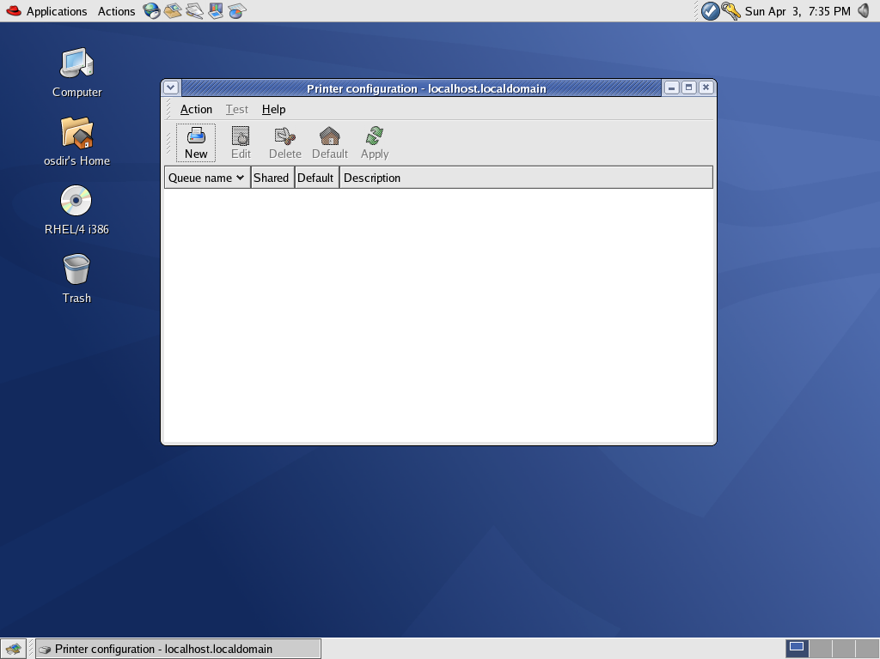

Slide 6
Setting Printer
Linux System Administration
The following types of print queues can be configured:
Locally-connected — a printer attached directly to the computer through a parallel or USB port.
Networked CUPS (IPP) — a printer that can be accessed over a TCP/IP network via the Internet Printing Protocol, also known as IPP (for example, a printer attached to another Red Hat Linux system running CUPS (Common Unix Printing System) on the network).
Networked UNIX (LPD) — a printer attached to a different UNIX system that can be accessed over a TCP/IP network (for example, a printer attached to another Red Hat Linux system running LPD (Line Printer Daemon) on the network).
Networked Windows (SMB) — a printer attached to a different system which is sharing a printer over a SMB network (for example, a printer attached to a Microsoft Windows™ machine).
Networked Novell (NCP) — a printer attached to a different system which uses Novell's NetWare network technology.
Networked JetDirect — a printer connected directly to the network through HP JetDirect instead of to a computer.

Slide 7
Linux Boot Time Scripts
Linux System Administration
Scripts/Programs added in /etc/rc.local are run at Boot Time.

Slide 8
Monitoring the System
Linux System Administration
Monitor Disk Usage (df)
Monitor CPU and Memory utilization (top)
Monitor process/services (ps, pgrep)
Monitor logs (/var/log/messages)
GUI Tool (Applications→ System Tools →System Performance)

Slide 9
Linux Rescue
Linux System Administration
Booting into Single User Mode
  At the GRUB screen, press e
  Select the kernel and type a
  Write single at the end of the line (after leaving a space)
  Boot by pressing b
Booting into Rescue Mode
  Boot the system using Installation CD #1
  Type “linux rescue” at the installation boot prompt

